Slide 1
Parallel Computing: Molecular Dynamics Simulation
By Srinija Nalluri

Slide 2
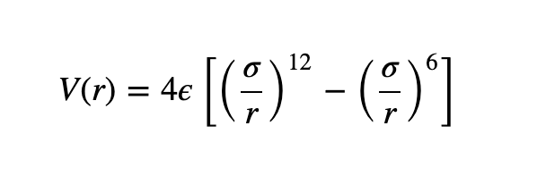
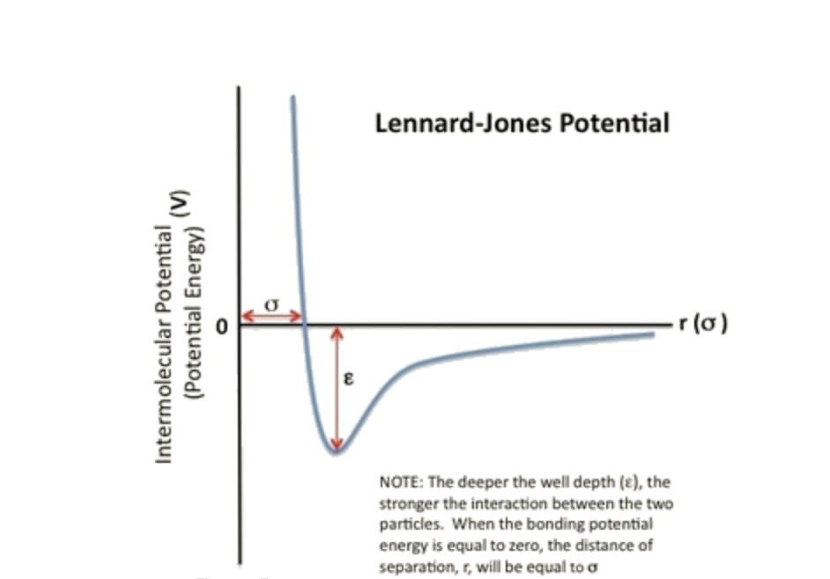
Lenard Jones Potential
The potential energy between two non-bonding particles can be described using the Lenard Jones potential
Source: https://chem.libretexts.org/Bookshelves/Physical_and_Theoretical_Chemistry_Textbook_Maps/Supplemental_Modules_(Physical_and_Theoretical_Chemistry)/Physical_Properties_of_Matter/Atomic_and_Molecular_Properties/Intermolecular_Forces/Specific_Interactions/Lennard-Jones_Potential
Notes:
Particles can be atoms or molecules
The interaction between two non-bonding particles based on their distance of separation

Slide 3
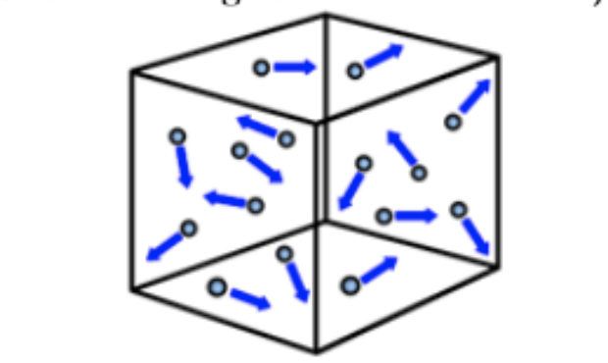
The Problem
There are N particles, randomly placed in a 3D box with 10x10x10 dimensions. The particles i and j interact with the Lenard-Jones potential. Calculate the total force on each particle.
N = 2⁶ x 28

Slide 4
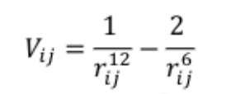
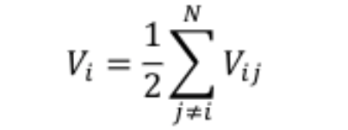

Lenard Jones Force
Lenard Jones energy on each particle
Total energy on each particle:
Total force on each particle:

Slide 5
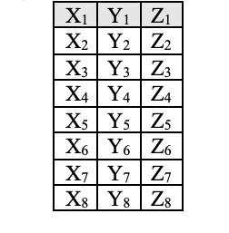
Algorithm
Algorithm implemented on parallel computer P = 28, 56, and 112 processing cores
The root processor is the core with rank = 0
Suppose there are 8 particles randomly placed in a box
In the root processor:
Particle 1
Particle 2
.
.
.
Particle 8
Randomly generated positions of each particle

Slide 6
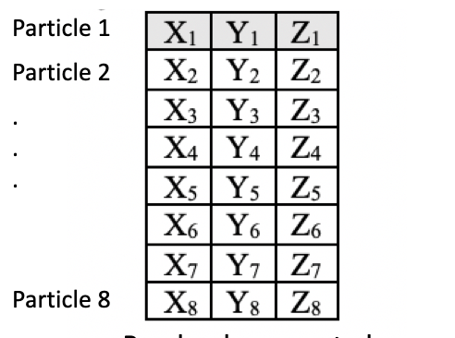
ij Matrix
Particle 1 interacts with 2, 3, 4, 5, 6, 7, and 8
Particle 2 interacts with 3, 4, 5, 6, 7, and 8
Particle 3 interacts with 4, 5, 6, 7, and 8
And so forth

Slide 7
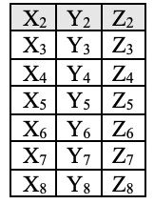
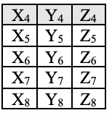
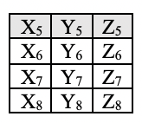
Algorithm
In the root processor :
In an iteration that runs N-1 times:
1st iteration
2nd iteration
x iteration
x+1 iteration
. . .
Matrix is sent to processor 1
Matrix is sent to processor 2
Matrix is sent to processor N-1
Matrix is sent to processor 0

Slide 8
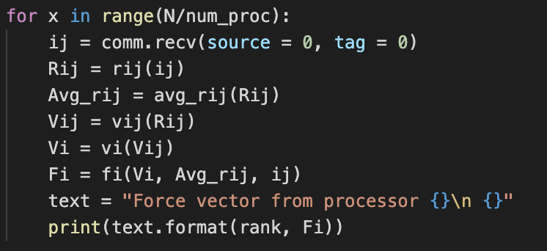
Algorithm – Parallelization
Excluding the root processor:
With 2⁶ x 28 particles and 28 processors, each processor receives an ij matrix 64 times
With 2⁶ x 28 particles and 56 processors, each processor receives an ij matrix 32 times
With 2⁶ x 28 particles and 112 processors, each processor receives an ij matrix 16 times

Slide 9

Algorithm – Distance
Once the matrix is received at the other processors the potential energy and force calculations occur
First, calculate $r_{ij}$
$r_{ij}=\sqrt{{(x_{i}−x_{j})}^{2}+{(y_{i}−y_{j})}^{2}+{(x_{i}−x_{j})}^{2}}$
X₁ , Y₁ and Z₁ are gathered from the first row of ij
In a for loop, X_{j} , Y_{j} and Z_{j} are found from each row except the first row
i.e. $r_{13}=\sqrt{{(x_{1}−x_{3})}^{2}+{(y_{1}−y_{3})}^{2}+{(x_{1}−x_{3})}^{2}}$
3. r_{ij} is store in an array
i.e. $r_{1j}=[r_{12}, r_{13}, r_{14}, r_{15}, r_{16}, r_{17}, r_{18}]$

Slide 10

Algorithm - Lenard-Jones Potential
Second, calculate $V_{ij}$
$$V_{ij}=\frac{1}{r_{ij}^{12}}−\frac{1}{r_{ij}^{6}}$$
V_{ij} is stored in an array
i.e. $V_{1j}=[V_{12}, V_{13},V_{14},V_{15}, V_{16}, V_{17}, V_{18}]$

Slide 11
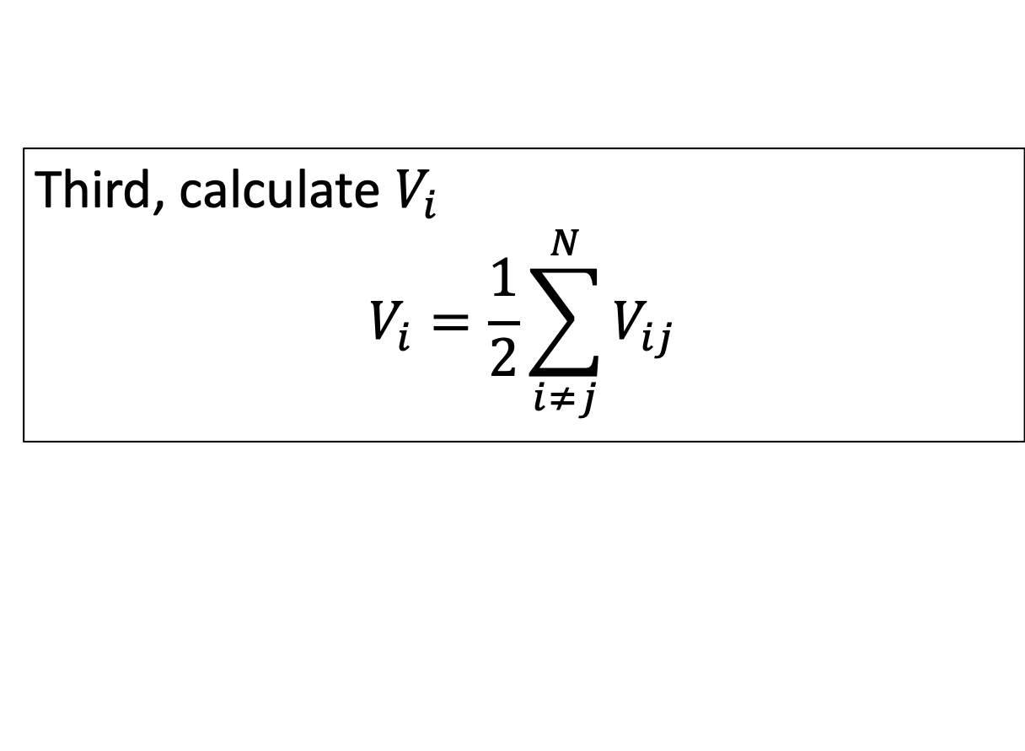
Algorithm – Total Energy
Third, calculate $V_{i}$
$$V_{i}=\frac{1}{2}\sum_{i≠j}^{N}{V_{ij}}$$

Slide 12

Algorithm – Total Force
Lastly, calculate $F_{i}$
$F_{i}=−∇V_{i}=−\frac{∂V_{i}}{∂x}\hat{i}−\frac{∂V_{i}}{∂y}\hat{j}− \frac{∂V_{i}}{∂z}\hat{k}$
$\frac{∂V_{i}}{∂x}=\frac{V\left(x+∆x, y, z\right)−V(x, y, z)}{∆x}$
$\frac{∂V_{i}}{∂y}=\frac{V\left(x, y+∆y , z\right)−V(x, y, z)}{∆y}$
$\frac{∂V_{i}}{∂z}=\frac{V\left(x, y , z+∆z \right)−V(x, y, z)}{∆z}$
Where $∆x= ∆y= ∆z= \frac{1}{10}\overline{r_{ij}}$
$F_{i}$ is stored in a 1D array as $F_{i}=[F_{x}, F_{y}, F_{z}]$

Slide 13
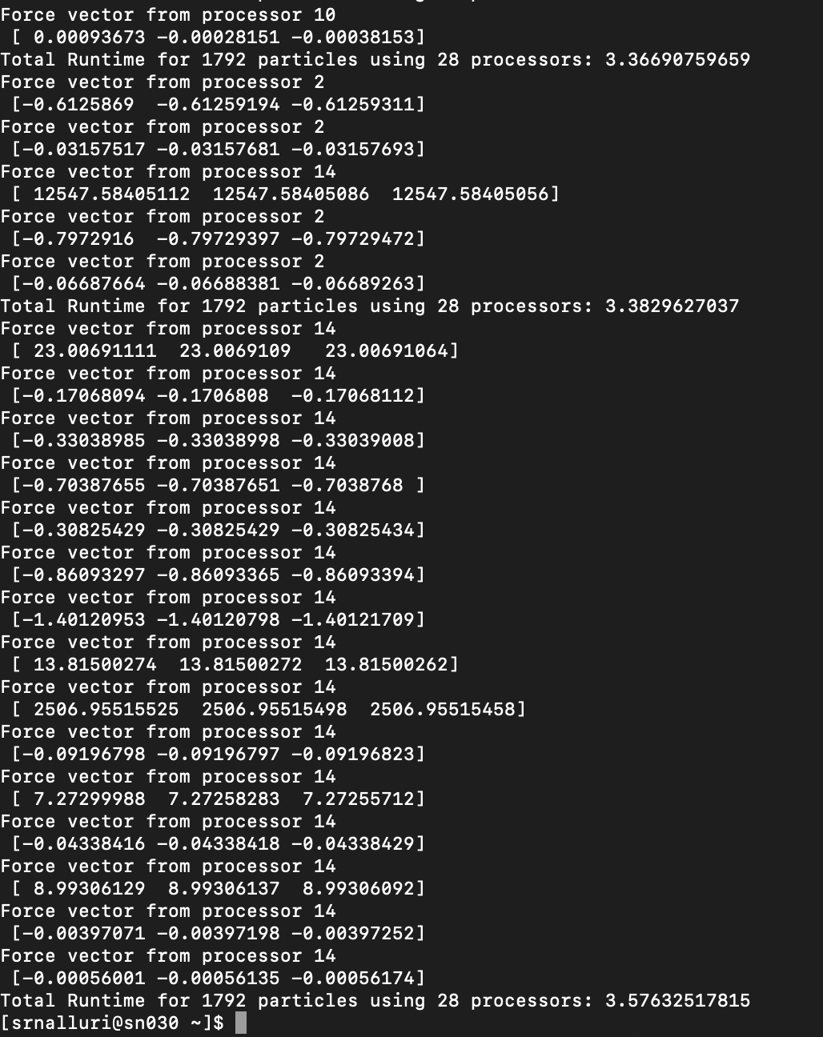
Results
N = 2⁶ x 28
P = 2⁰ x 28

Slide 14
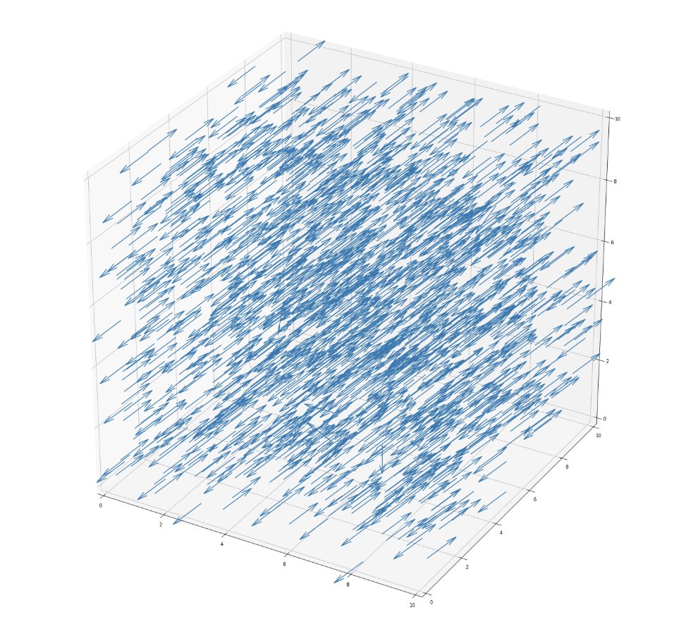
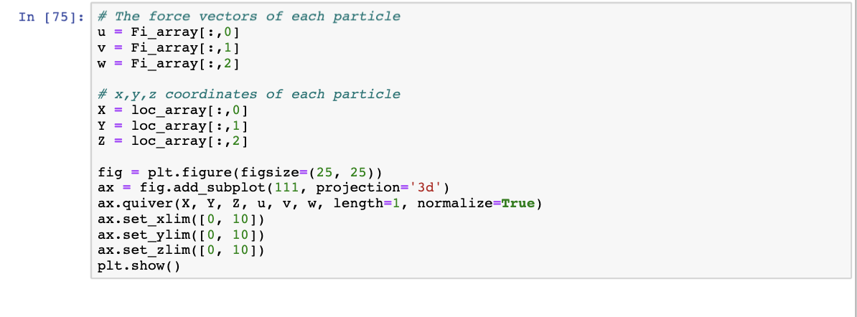
Results – Force Vectors

Slide 15
Results – Runtime Analysis
3 trials were performed for P = 28, 56, and 112
In each trial the program was run 10 times and runtime was averaged
Number of Cores | Average Runtime (s)
28 | 3.597713206
56 | 1.826821751
112 | 1.373110453
Notes:
MPI_Recv and MPI_Send is called N/P times so if you increase the number of cores, the amount of times MPI_Send() and MPI_Recv() decreases, therefore reducing the runtime

Slide 16
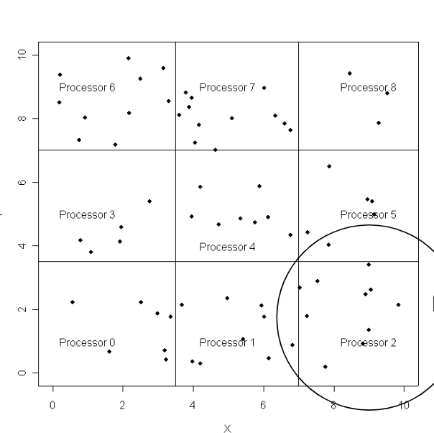
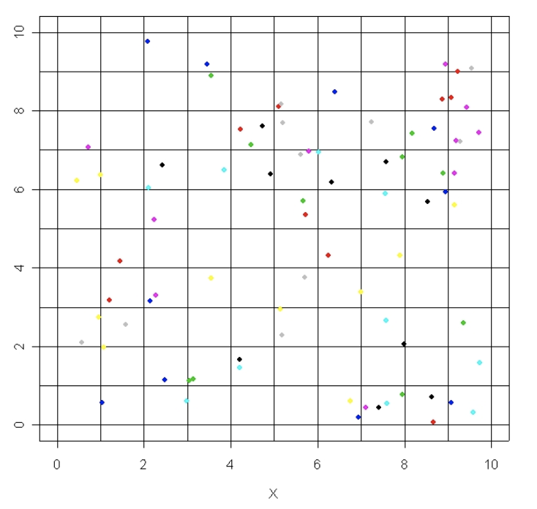
Alternative Approaches
Spatial Decomposition – Communication is restricted to nearby processors
Particle Decomposition – Each processor receives N/P particles
Notes:
Spatial - Communication is restricted to nearby processors and it great for reducing communication between processors and reduces memory usage . Disadvantage is load imbalance and difficult implementation
Particle Decomposition – Each particle gets N/P particles and stores each particle in an associated bin and then each processor calculates LJ Force on its particles after the all-gather. Do not need to loop through all the particles because LJ force is only calculated within the processor bins

Slide 17
Conclusion
Total Force
P = 28
P = 56
N = 1792 elements

